Slide 1

NLP
Customer
Review
Sentiment Analysis

Slide 2
Sentiment analysis
Arabic reviews(talabat)
Projects :
Sentiment analysis
English reviews (amazon)

Slide 3

Over View
Over View
Objective and importance
The data
Methodology
The results
challenges
Objective and importance
Data
Methodology
The results
Implementation

Slide 4
Objective and
Importance
Analyze the feelings of reviews to understand the opinions of users .
The importance of the topic:
--> Marketing
--> Customer support .
--> Decision making

Slide 5



Data
Data from Kaggle
Csv file( Talabat reviews)
Csv file ( Amazon reviews)
40k reviews in Tlabat Reviews
3.5M reviews in amazon reviews

Slide 6
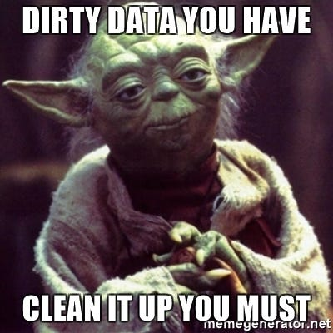
Methodology
1- Preprocessing
Normalization
Tokenization
Stop Words removal
Noice Removal
Handle Mixed Languages
Putting The Final Touches
2- Modeling
TF IDF Vectorizer
Models(SVM)
Models(ANN)
3- Implementation
Arabic stream
app
English stream app

Slide 7
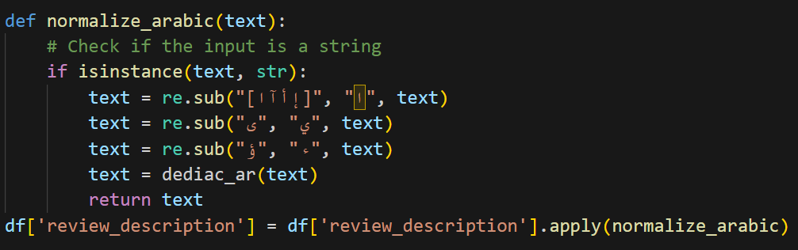
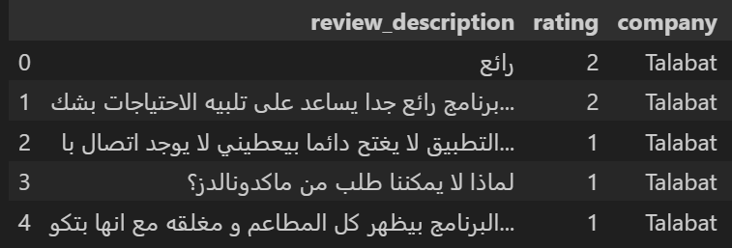
* Normalization in Arabic Natural Language Processing (NLP) refers to the process of standardizing and simplifying the text to reduce variations and ambiguities while preserving the meaning.
It is particularly important in Arabic because of the language's rich morphology, multiple forms of the same word, and presence of diacritics and special characters.
Here are the main components of Arabic text normalization:
Normalization:

Slide 8
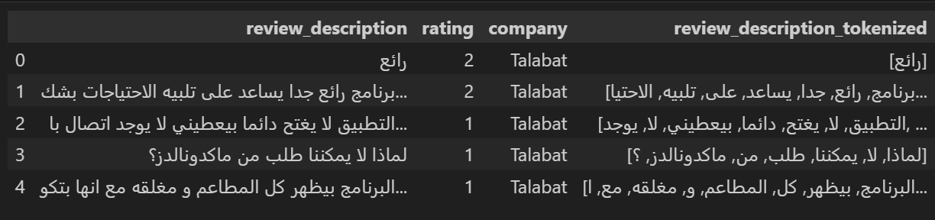
Tokenization is the process of breaking text into smaller units, called tokens, which can be words, subwords, or characters. It is a crucial preprocessing step in Natural Language Processing (NLP) for tasks like text classification, sentiment analysis, or machine translation.
Tokenization in Arabic poses unique challenges due to the language's complex morphology, rich vocabulary, and the presence of prefixes, suffixes, and clitics.
Tokenization:

Slide 9
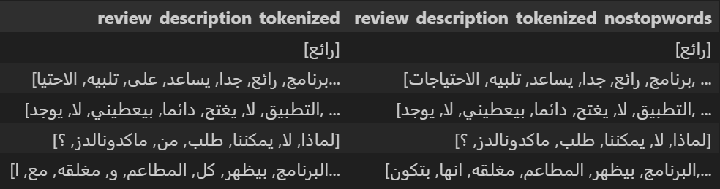
StopWords Removal:
* Stop Words are commonly used words in a language that carry little semantic meaning, such as "the," "is," "in" in English or "هذا," "لكن," "لم" in Arabic. Removing these words helps reduce noise in text data and focuses on meaningful content during NLP tasks like text classification, sentiment analysis, and machine translation.
* We Remove stop words without *****{"لم", "لن", "لا", "لكن"}*****

Slide 10
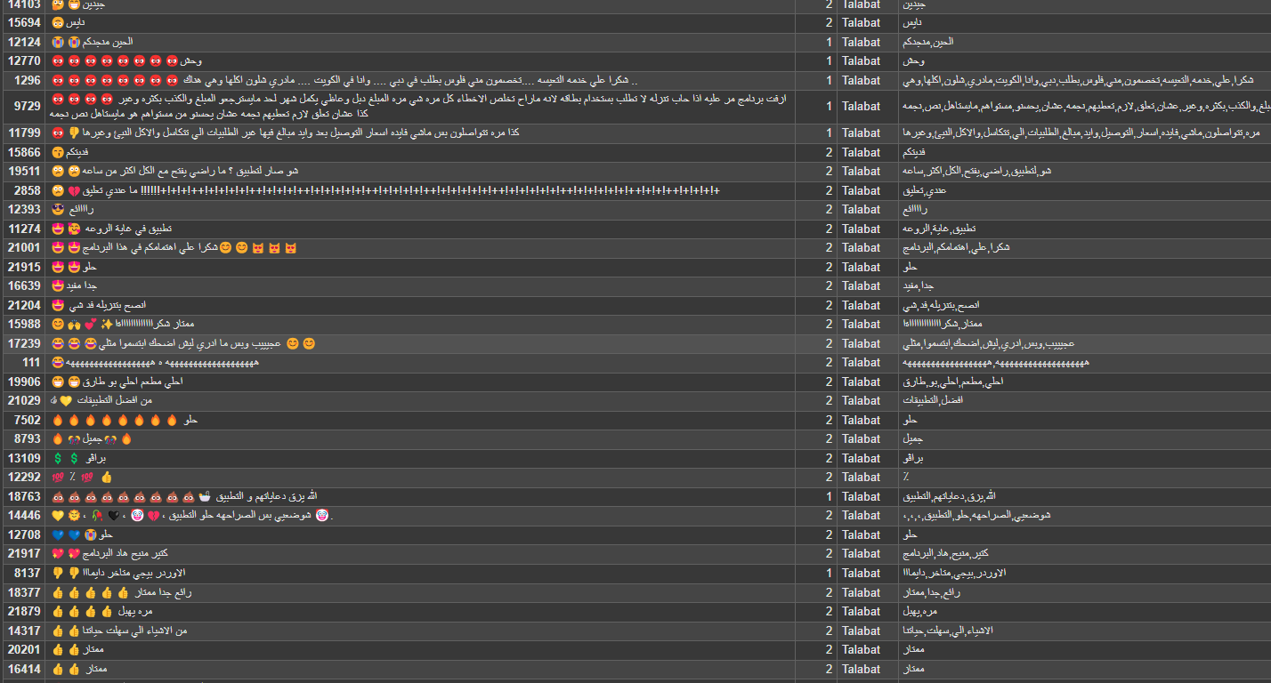
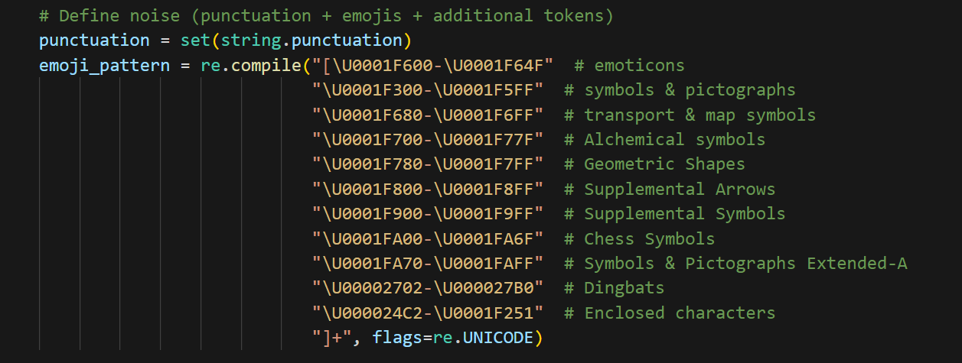
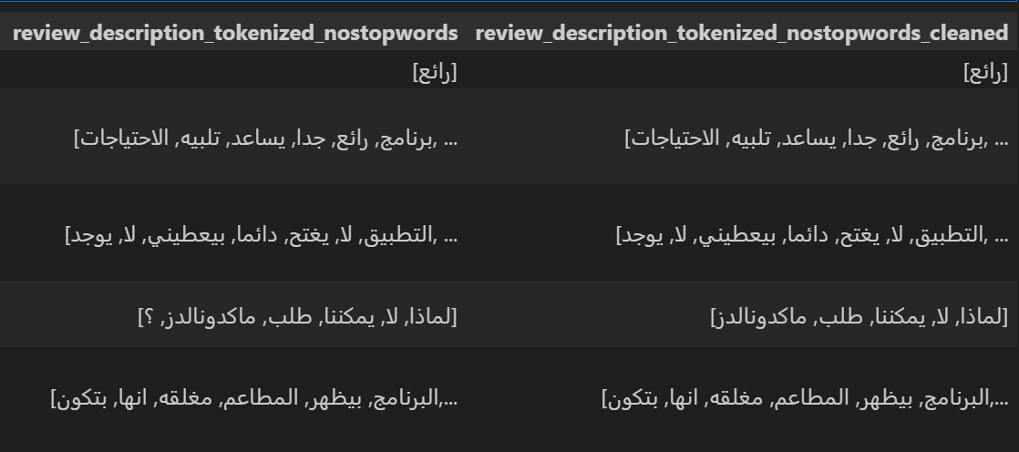
Noice Removal:
Noise removal involves cleaning text by eliminating unwanted characters, symbols, or irrelevant elements that can negatively affect NLP tasks. Arabic text often includes additional challenges like diacritics, special characters, and mixed-language content.

Slide 11
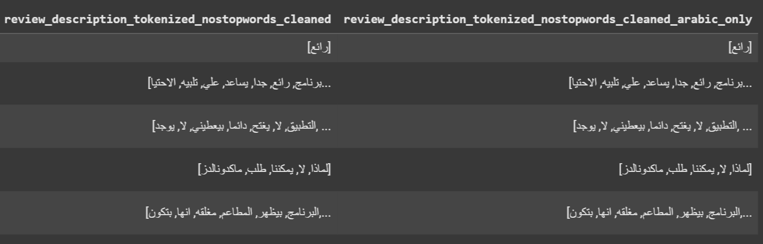
Handle Mixed Languages:
Handling mixed-language text, especially when it includes Arabic and another language like English (or Arabizi), is essential for accurately processing and analyzing real-world text data. Below is a structured approach to deal with mixed-language content in text preprocessing.

Slide 12
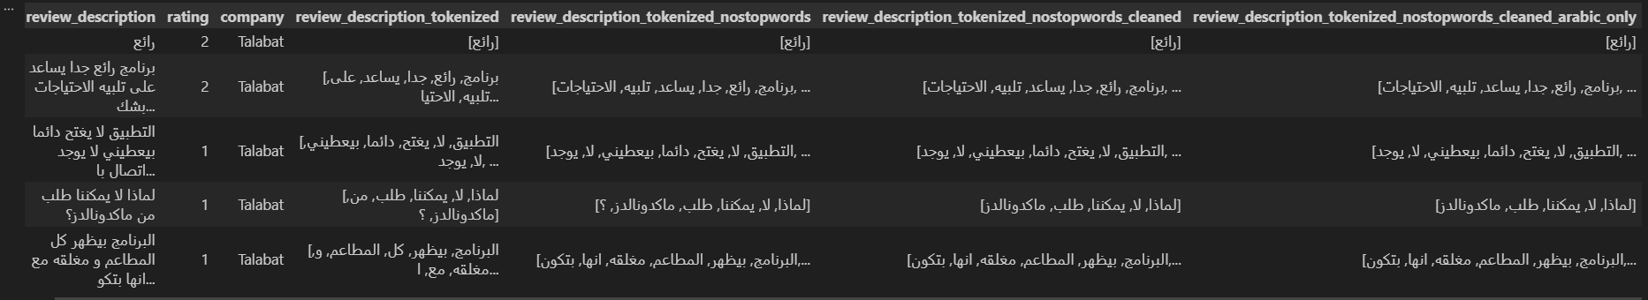
Preprocessing:

Slide 13
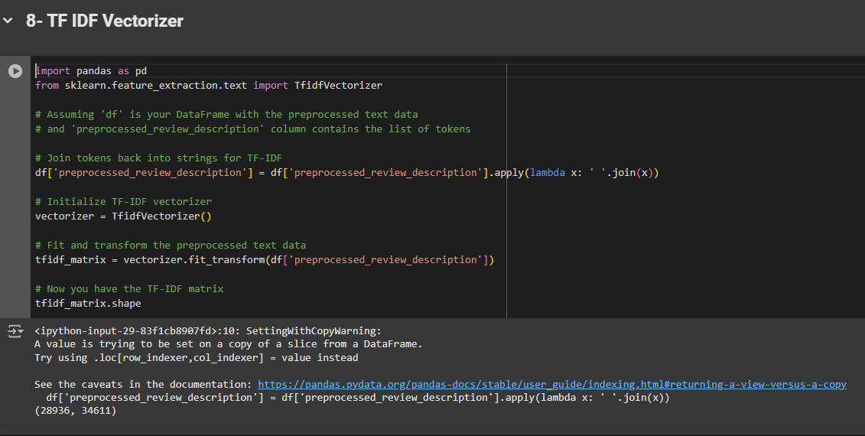
TF IDF Vectorizer:
•The TF-IDF (Term Frequency-Inverse Document Frequency) Vectorizer is a method used in natural language processing and information retrieval to convert textual data into numerical features. It evaluates the importance of a word in a document relative to a collection of documents (corpus). Words that appear frequently in a specific document but rarely across the corpus are given higher weights.

Slide 14
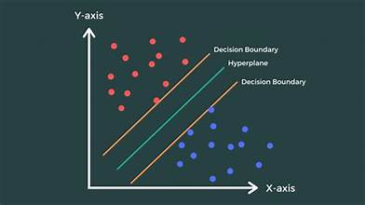
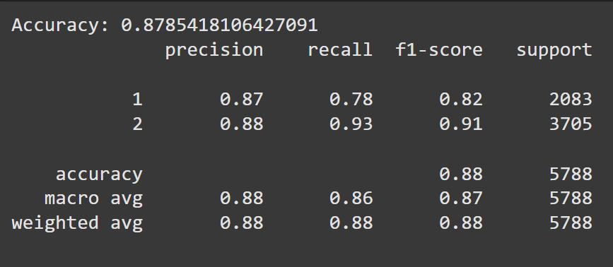
The results
(Talabat reviews)
Support Vector Machine (SVM) is a supervised machine learning algorithm primarily used for classification and regression tasks.
SVM aims to find the optimal boundary (or hyperplane) that separates data points of different classes in the feature space. This hyperplane maximizes the margin, which is the distance between the hyperplane and the nearest data points from each class.

Slide 15
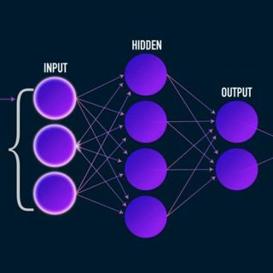
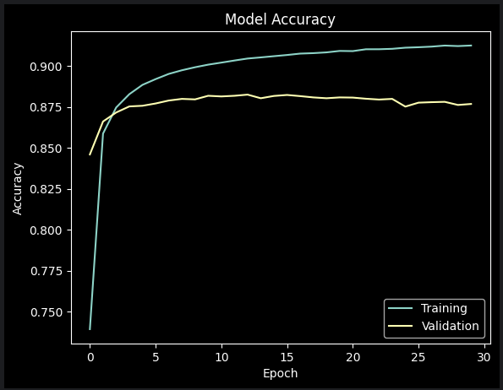
The results
(Amazon reviews)
Acc : 87.68

Slide 16
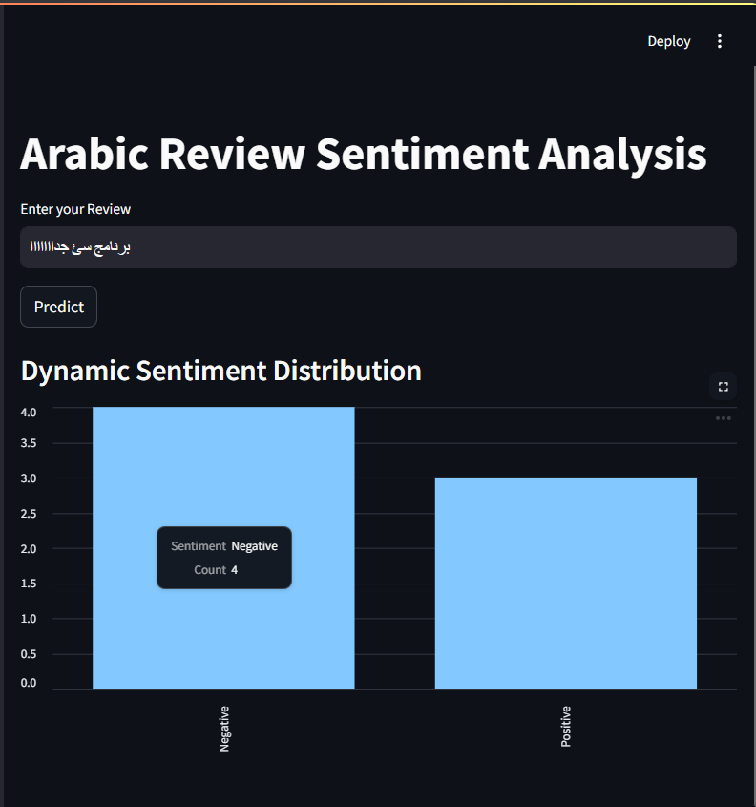
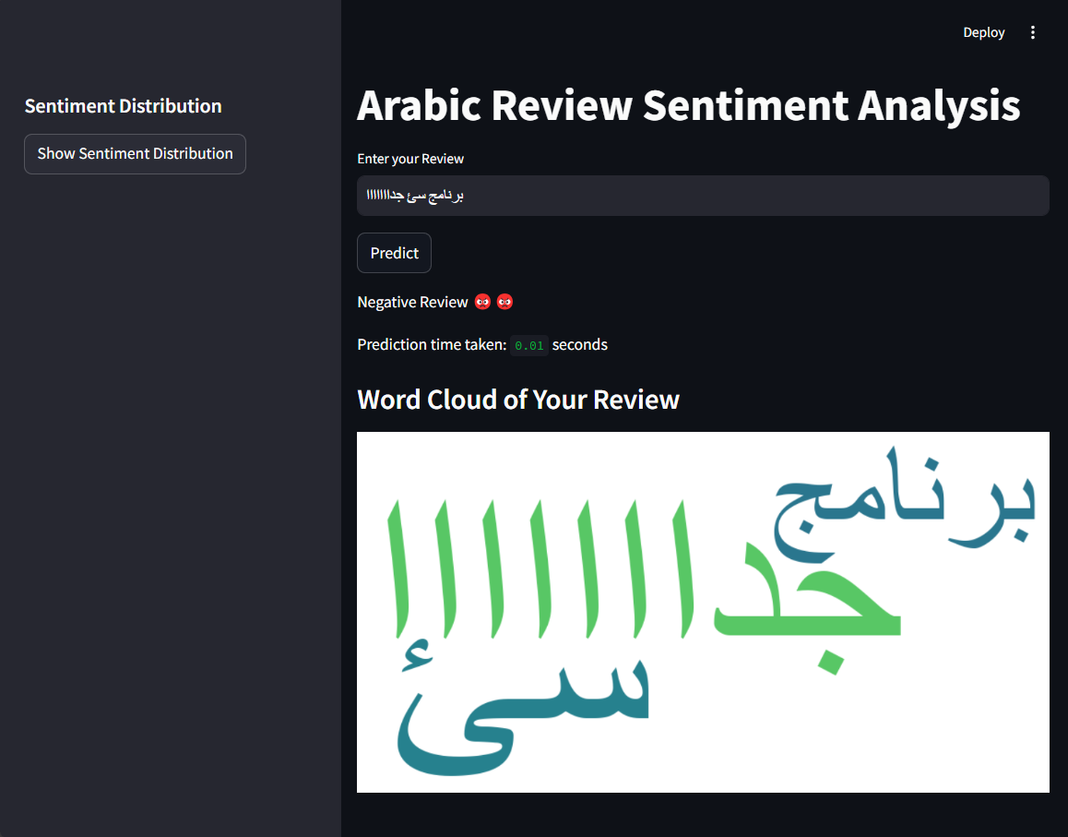
Implementation:

Slide 17
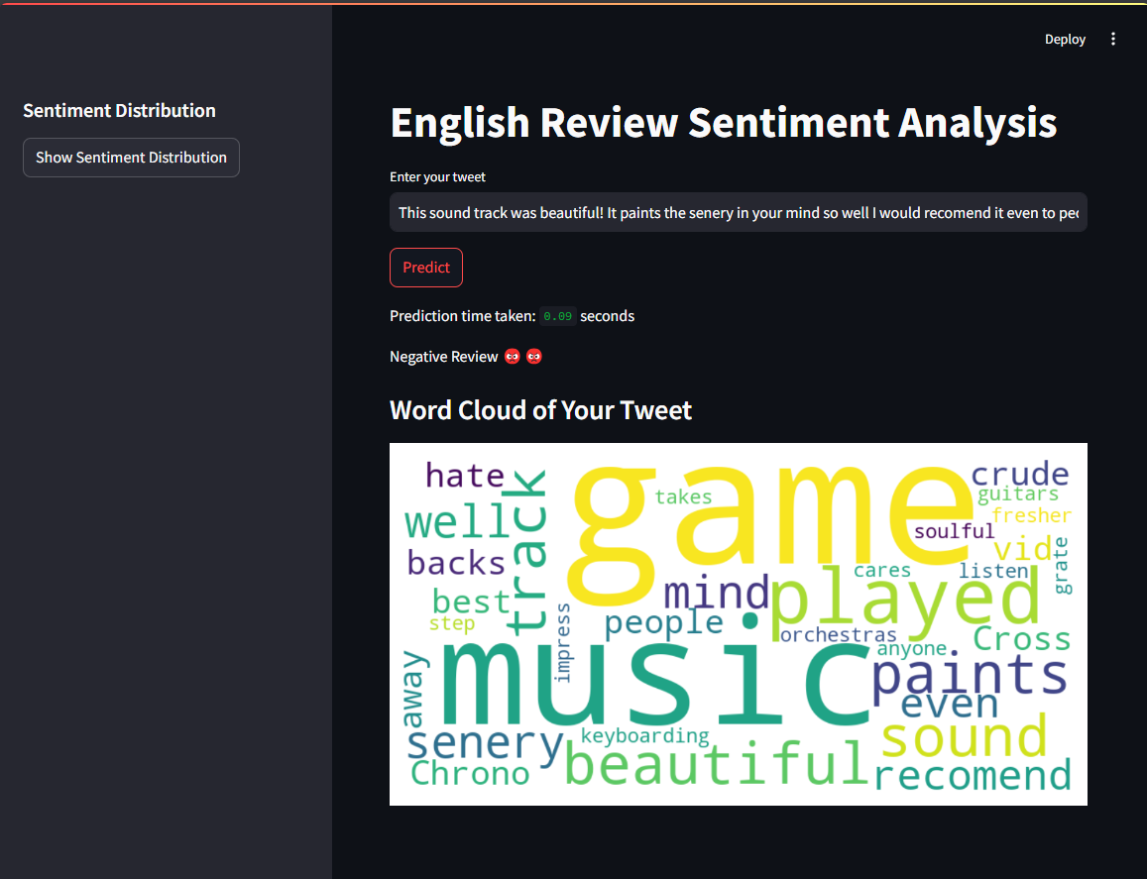
Implementation:

Slide 18
Team members :
Sherif samy
Mohamed wisam
Rawan abdelgwad
Rawda rizk
Sayed tag
Hassan

Slide 19
Thank you:

